Slide 1


Data Analysis

Slide 2


Today's agenda
Project recap
Problem
The Analytics team
Process
Insights
Summary

Slide 3

Social Buzz is a rapidly rising technology unicorn that must quickly adjust to its worldwide scope. Accenture has initiated a three-month proof-of-concept focusing on the following tasks:
An audit of Social Buzz’s big data practice
Recommendations for a successful IPO
Analysis to find Social Buzz’s top 5 most popular categories of content
Project Recap

Slide 4

Problem
Every day, about 100,000 posts are made.
Every year, 36,500,000 pieces of content are created.
How to profit on such massive amounts of unstructured data.
Investigation to discover the top five most popular content categories on Social Buzz

Slide 5



Andrew Fleming Chief Technical Architect
The Analytics team
Marcus Rompton Senior Principle
Gauri Jadhav
Data Analyst

Slide 6
Process
1
Data Gathering
2
Data Cleaning
3
Data Modeling
4
Data Analysis
5
Uncovering Insights

Slide 7

Insights
16
UNIQUE
CATEGORIES
1897
REACTIONS TO “ANIMAL” POST
JANUARY
MONTH WITH MOST POST

Slide 8
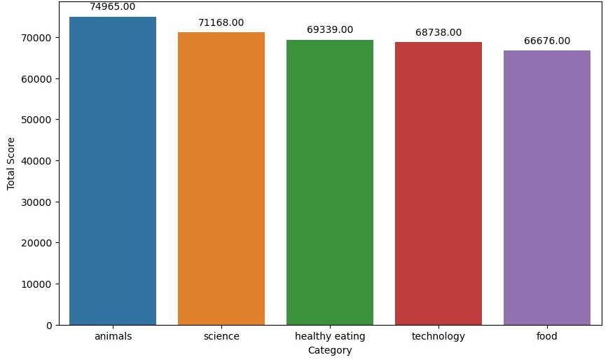
Top 5 Categories by Aggregate popularity

Slide 9
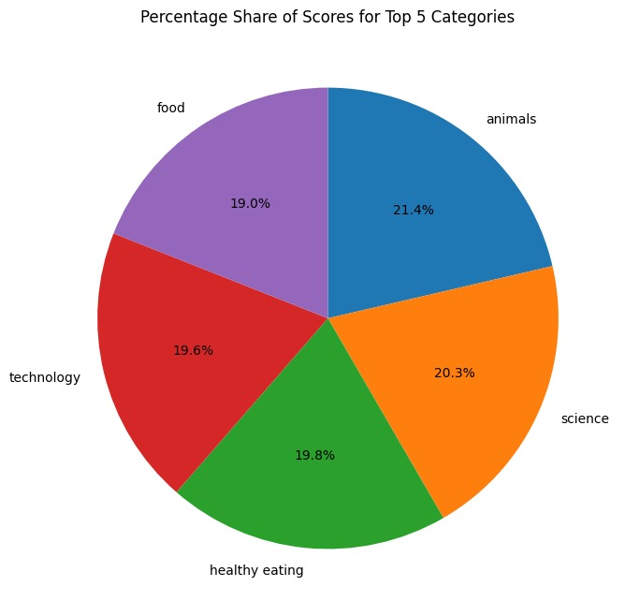
Proportion of Total Reaction Scores

Slide 10

The Top 5 categories were
Animal
Technology
Healthy Eating
Science
Food
Food seems to be prominent
This analysis is limited due to small sample provided and short time frame.
Summary

Slide 11
Thank you!
ANY QUESTIONS?

